Slide 1
Mesh Segmentation and labeling
Rohit Rao P
SBU ID: 111447392

Slide 2
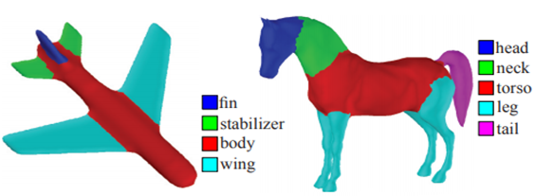
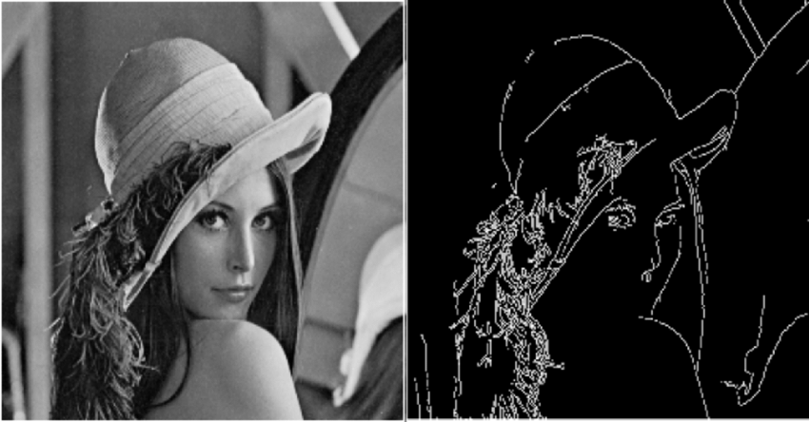
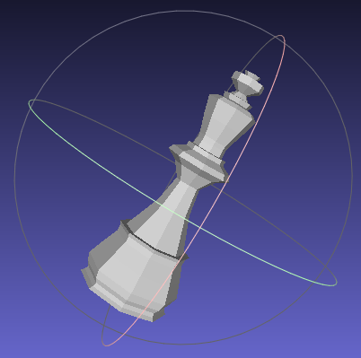

Overview
What is Mesh Segmentation? Why are Mesh Features important?

Slide 3
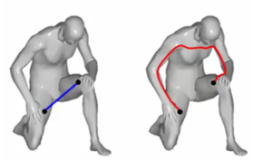
Geodesic Distance
Surface Property
Fast Marching
Planar Propagation
Average of all distances
between face of mesh and
all the other faces.

Slide 4
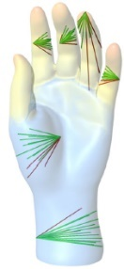
Shape Diameter function
Volume property
Poise invariant
Approximation to distance from surface to
medial axis

Slide 5
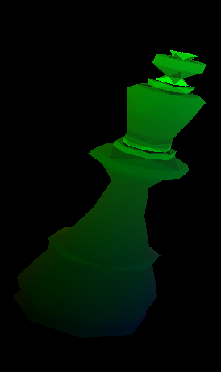
Curvature
Surface Property
Gaussian and Mean curves
Features computed using principle Curvatures.

Slide 6
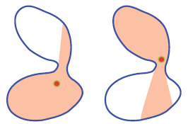
Volumetric Shape Images
Motivated by idea that change in part mostly corresponds to distinct change in volume.
2 Pass feature
First Pass a simple SDF
Random sampling in the second pass
Better Approximate when compared to SDF.

Slide 7
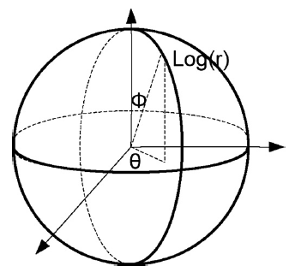
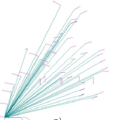
Shape Context
Couple Surface qualities geodesic distance and orientation of the mesh face.
Histogram = (log (geodesic distance),Angle between face Normal and vector to other face).

Slide 8
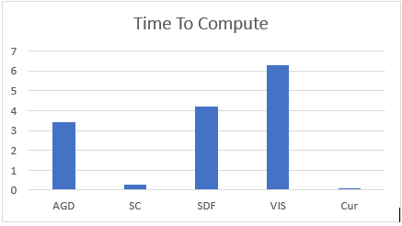
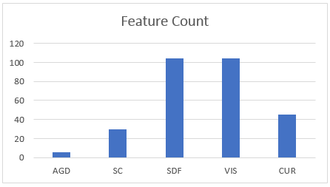
Feature Generation Analysis
SDF and VIS generate the most features, AGD and VIS is most time consuming

Slide 9
Mesh Labeling
Good Mixtures of surface and volume properties
Random Forest classifier
Fast
Similar accuracy when compared to SVM (92%)
Classification precision of 91%

Slide 10
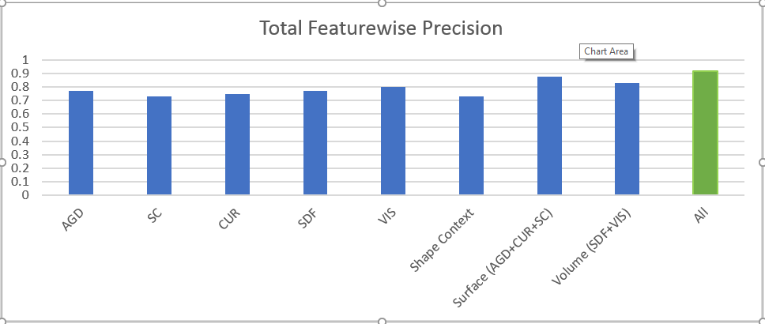
Classification Analysis
Collection of Features is better than individual feature
Mixture of surface and volume of features improves the classification.

Slide 11
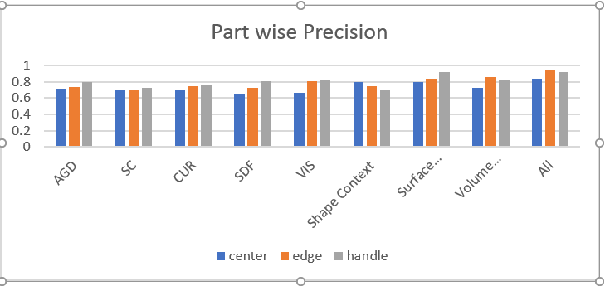
Classification Analysis
Accuracy at boundaries are low due to missing pairwise features.

Slide 12
Future Enhancement
Tried and miserably failed
Deep Learning using FCN: Lack of compute power, Loss not reducing i.e gradients was not converging
Labeling optimization using Graph Cut algorithm.
Identify “cheap to compute” feature which can used to drive a fast classifier such as extreme learning machine to handle online segmentation.
Improve execution time of Average geodesic distance using idea of heat kernels.
Improve execution time of Shape diameter function using octree.

Slide 13

Final Overview
Project Proposal | Final Demo
Average Geodesic Distance | Average Geodesic Distance
Shape Diameter Function | Shape Diameter Function
Curvature | Curvature
Shape Context | Shape Context
 | Volumetric Shape Images
 | Mesh Labeling

Slide 14
open Source Declaration
Ray Triangle intersection algorithm directly taken from Wikipedia and ScratchAPixel blog post.(https://www.scratchapixel.com/lessons/3d-basic-rendering/ray-tracing-rendering-a-triangle/moller-trumbore-ray-triangle-intersection)

Slide 15
Questions?

